Slide 1
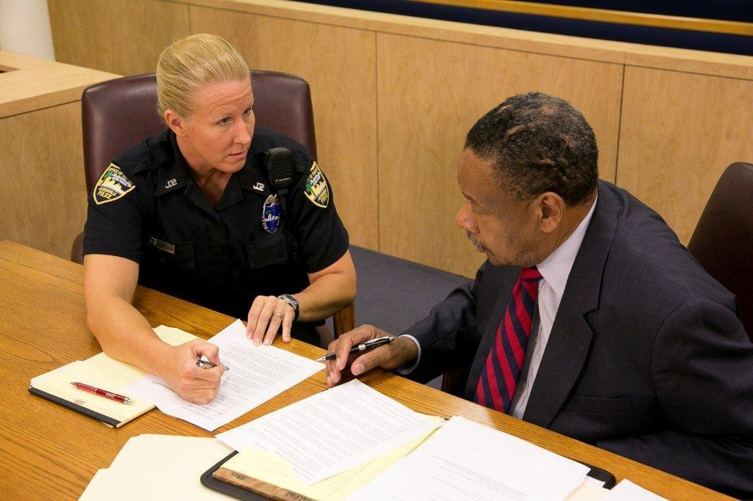
Session 28
Case Preparation
and Testimony

Slide 2
Learning Objectives
Conduct a thorough pre-trial and prepare for testimony
Provide clear, accurate, and descriptive direct testimony
Respond effectively and appropriately to cross examination

Slide 3
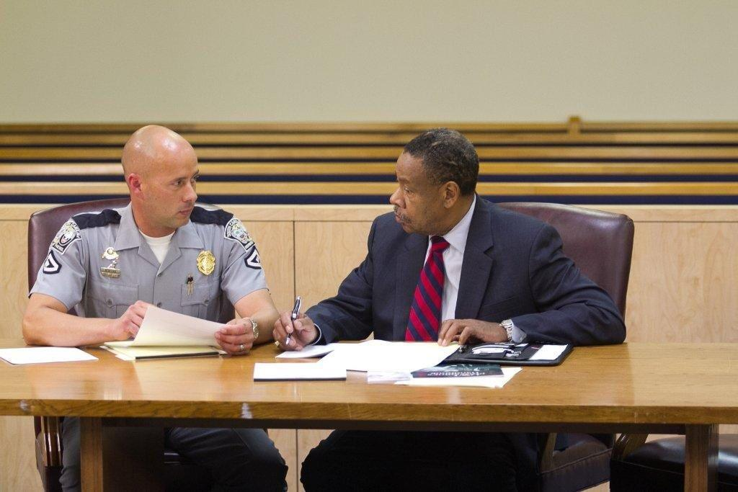
Preparation

Slide 4
Pre-Trial Conference
Goals of the Pre-Trial Conference
Educate yourself and the DA
Explain the DRE process and the differences between a normal DUI case and a DRE case
Discuss questions to be asked
Discuss possible defenses and defense experts
NDAA/NTLC Booklet

Slide 5
You must review everything
REVIEW all of the reports and evidence yourself
REVIEW all of the reports and evidence with your DA, and make sure that he or she has REVIEWED all such reports and evidence as well
REVIEW all videos and recordings involved with the case
REVIEW your Curriculum Vitae and make sure it is updated
REVIEW all of the DRE conclusions in relation to the toxicology report
MAKE exhibits as necessary

Slide 6
Pre-trial Meeting with Prosecutor
Important things to remember for the pre-trial meeting:
Your review of the case should be done before this meeting
Communication is more than just talking, it requires active listening and genuine responses
Honest and open communication in this meeting will aid in reduce anxiety at trial
You know more than the report and video. Let the prosecutor know everything that you know
Ensure that the prosecutor has a copy of everything in your file and knows about every piece of evidence in the case

Slide 7
Pre-trial Meeting with Prosecutor
Discuss all Discrepancies and/or Omissions
Point them out to the prosecutor
Discuss why they occurred
Discuss how to address them in court
Prepare a plan for Cross-examination

Slide 8
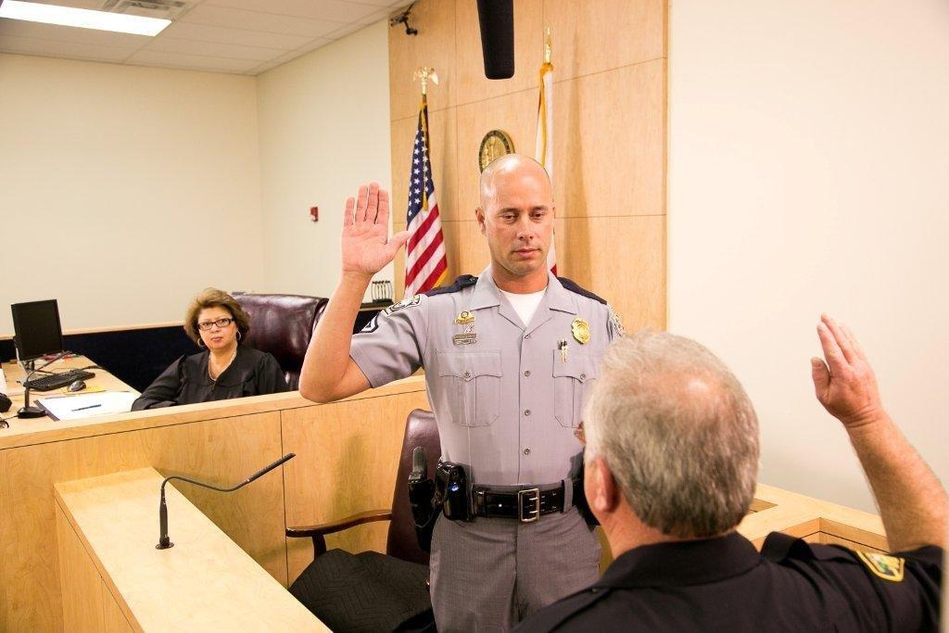
Direct Testimony

Slide 9
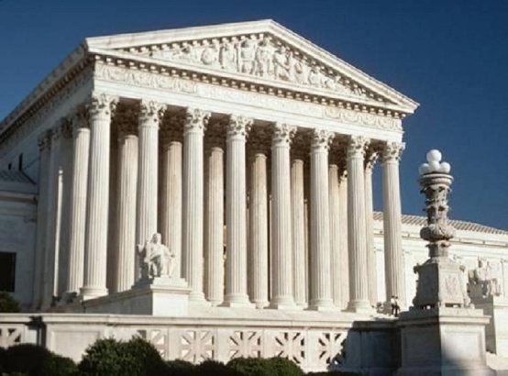
New Scientific Principle
Tennessee courts employ a Daubert+ standard
They follow the factors found in McDaniel v. CXS Transp., 955 S.W.2d 257

Slide 10
McDaniel v. CXS Transp., 955 S.W.2d 257
Whether scientific evidence has been tested and the methodology with which it has been tested
Whether the evidence has been subjected to peer review and publication (validation studies)
Whether the potential rate of error is known
Whether the evidence is generally accepted in the scientific community, and
Whether the expert’s research in the field has been conducted independent of litigation
Underlined wording is added to the Daubert factors

Slide 11
1) Testing and Methodology
1) Whether scientific evidence has been tested and the methodology with which it has been tested
ANSWSER : NHTSA & IACP have analyzed the validity and reliability of the DEC program through their own funded studies as well as independent studies. These studies confirm that the DEC program has been rigorously tested and is highly accurate in predicting impairment. Also, the DEC program has been proven to be reliably performed by law enforcement officers who have completed DEC training.
(LAPD/NTSHA and John Hopkins Univ. studies)

Slide 12
Validation Studies
Identify Types of Drug Intoxication: Laboratory Evaluation of a Subject Examination Procedure, May 1984 Final Report. George E. Bigelow, Ph.D. et. al Behavioral Pharmacology Research Unit, Department of Psychiatry and Behavioral Sciences by the U.S. Department of Transportation’s NHTSA and National Institute of Drug Abuse NHTSA, Pub. No. DOT HS 806 753 (1985) (Known as the “John Hopkins” study)
Field Evaluation of the Los Angeles Police Department Drug Detection Procedure, February 1986, DOT HS 807 012, A NHTSA Report, National Highway Traffic Safety Association Richard P. Compton

Slide 13
Other Validation Studies
Drug Recognition Expert (DRE) Validation Study. (Burns, M. and Adler, E.V.) (1994) Final Report, E0072023, Governor's Office of Highway Safety, State of Arizona)
Field Study involving 484 DUI arrested Participants; 62 DRE Evaluators from Phoenix PD; 4 Drug categories involved (Marijuana, Depressants, Stimulants, and Narcotic Analgesics)
Results: Marijuana 90%: Depressants 96%; Stimulants 92% Narcotic Analgesics 94.5%; Overall 91% Correct
The DRE program is a valid method for identifying and classifying drug-impaired drivers

Slide 14
Other Validation Studies
An examination of the validity of the standardized field sobriety test in detecting drug impairment using data from the drug evaluation and classification program, A. Porath-Waller, D. Beirness (2013)
Field Study involving 2,142 DEC evaluations from Canada; only DREs involved from 1995 - 2009; 5 single-drug, categories were involved (Stimulants (S), Depressants (D), Cannabis (C), Narcotic Analgesics (NA) and No Drugs (ND)
Results: HGN: S 94.6%, and D 70%; OLS: S 59.9%, C 55.4%, and NA 10.6%; WAT: S 72.2%, C 39.7%, D 9% and NA 3.5%; Overall 95% Correct and all Non-Drug participants were correctly identified
The SFSTs are valid screening tools for identifying and classifying all drug-impaired drivers

Slide 15
Other Validation Studies
Drug recognition expert examination characteristics of cannabis impairment, Hartman R., Richman J., Hayes C., Huestis M., (2016) (The 302 study)
Field Study involving 302 Marijuana impaired Participants (DRE cases collected from 2009 to 2014 from 9 U.S. States) and Lab Comparison involving 302 Non-impaired Participants;
DEC program was found reliable in determining cannabis impairment
The most reliable DEC metrics are: At least 3 Finger-to-Nose misses; Eyelid Tremors during Modified Romberg (or HGN); Swaying during One-Leg-Stand; at least 2 indicators on Walk-and-Turn; Rebound Dilation; Lack of Convergence; Elevated Pulse; and Dilated Pupils
Results: 96.7% correct when at least 2 of the 4 above tests have the stated indicators present

Slide 16
Other Validation Studies
Cannabis Effects on Driving Skills, Hartman R., Huestis M., (2013) 1. Cannabis smoking increases lane weaving and impaired cognitive function. Critical-tracking tests, reaction times, divided-attention tasks, and lane-position variability all show cannabis-induced impairment 2. Combining cannabis with alcohol enhances impairment, especially lane weaving 3. Evidence suggests recent smoking and/or blood THC concentrations 2–5 ng/mL are associated with substantial driving impairment, particularly in occasional smokers 4. Cannabis effects include alterations in reaction time (RT), perception, short-term memory, attention, motor skills, tracking, and skilled activities

Slide 17
2) Publication
2) Whether the evidence has been subjected to peer review or publication
ANSWER: Many peer review articles and publications indicate that the DEC program is a valid, accurate and reliable test for drug impairment.
(See validation studies)

Slide 18
3) Error Rate
3) Whether a potential rate of error is known
ANSWER: The DEC program has a known error rate, for each particular drug category. Study the known error rates and be able to refer to the validation studies that conclude these error rates are accurate and reliable. Most validation studies were between 3 and 14% error rate, which is much higher than a mammon gram or a flu test.

Slide 19
4) Acceptance
4) Whether ... the evidence is generally accepted in the scientific community
ANSWER: The Connecticut Association of Optometrists (CAO) and the New Jersey Society of Optometric Physicians (NJSOP) have formally adopted resolutions accepting the DEC program. Many Physicians, Universities and Hospitals have conducted studies accepting the accuracy and reliability of the DEC program. Also, the ACLU has endorsed the DEC program.

Slide 20
5) Research
5) Whether the expert's research in the field has been conducted independent of litigation
ANSWER: Yes, again refer to the many validation studies that were conducted independent of litigation

Slide 21
DRE Testimony in Tennessee
State v. Brewer, 2020 Tenn. Crim. App. LEXIS 221 (Apr. 6, 2020)
“The methods and underlying data used by the LAPD and NHTSA in developing the field DRE were appropriate and exhaustive. This was followed up by extensive studies at John Hopkins University . . . The Court concludes that the evidence can substantially assist the trier of fact as required by Rules 702 and 703…”
Chief Hickman qualified to testify as a DRE expert

Slide 22
State v. Brewer
Opinion of court of criminal appeals:
“The trial court complied with both Tennessee Rule of Evidence 702 and 703 and concluded that the testimony was admissible. While not explicitly naming the McDaniel factors, the trial court aptly considered the development of the test and its reliability when determining whether to admit the testimony.”

Slide 23
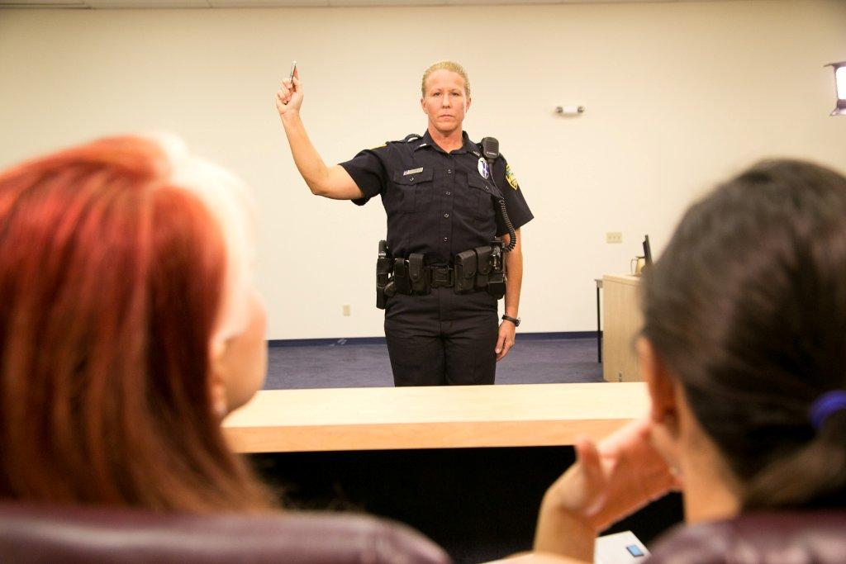
General Guidelines

Slide 24
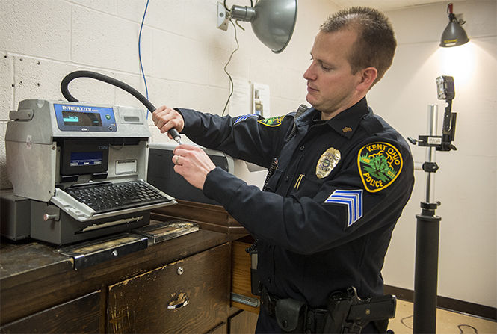
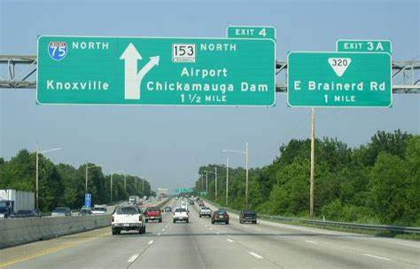
Review-Getting Ready
Review your training materials
Prepare to discuss your certifications and procedures
Prepare to tell the relevance of SFSTs to drugs
Prepare to discuss the validation studies

Slide 25
Direct Examination As A DRE Expert
The DRE should be qualified as an Expert each time he or she testifies:
Just because you have been qualified before does not mean that you will qualify this time
Make sure you know how many times, when and where your have been qualified
Don’t undermine your extensive training and experience by glossing over your qualifications!
Don’t allow the DA to stipulate to your qualifications!

Slide 26
Direct Examination
Always be prepared be professional :
Make sure you to come to court well dressed and well groomed
Make sure both you and your DA are extremely familiar with all aspects of DRE training and the DRE report

Slide 27
Being Professional – Maintaining Control
Listen to the questions
Pause before answering the questions
Use plain language
Answer the questions based on your memory and recollection
Relate Training and Experience
Remain calm and confident
Look at and speak to the jury (or judge if it is a bench trial)

Slide 28
Direct Examination
Don’t be this guy…

Slide 29
Direct Examination
Be this guy instead…

Slide 30
And Never, Never be put in this situation!

Slide 31
Rendering An Opinion
How much time did you spend with the defendant that night?
How long did the evaluation process take?
Based on your training, experience, and the evaluation you performed on the defendant, did you form an opinion as to whether the defendant was under the influence of alcohol and/or drugs?
What is that opinion?
What is the basis for this opinion?

Slide 32
Rendering An Opinion
What were the significant factors that made you arrive at your opinion?
Do you have an opinion as to what type of drug(s) was influencing the defendant?
What is that opinion?
What is the basis for that opinion?
Are you familiar with the drug ______?
Is that drug within the category of drugs you indicated was influencing the defendant?
What signs and symptoms would you generally expect to see in a person under the influence of that drug?
How long does it take for that drug to influence an individual once they have taken it?
How long will the effects of that drug last?

Slide 33
Rendering An Opinion
Do you have an opinion on whether or not a person under the influence of this category of drug could affect their ability to operate a motor vehicle safely?
What is your opinion?
What is the basis for that opinion?
Given your observations of the defendant and the information you just testified to, do you have an opinion as to whether or not the defendant could safely operate a motor vehicle given his/her impairment?
What is that opinion?
What is the basis for that opinion?

Slide 34
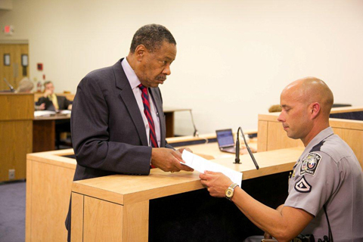
Typical Defense Tactics
Challenging observations and interpretations
Challenging credentials

Slide 35
Cross-Examination
Three types of Questions:
1) Concessions (Agree to things that help them)
2) Impeachment (Everything you did was wrong)
3) Competency Attack (You don’t have the expertise to do what you did or to say what you said)

Slide 36
Defense Challenges
The General Theory or Principle the Expert Relies On​
The Factual Bases of the Expert's Opinion​
Expert's Qualifications

Slide 37
Defense Challenges
Not a Medical Doctor/Toxicologist​
Little or No Training/Experience​
No formal education in scientific/medical field​
Don't know the "science"​
Other Medical cause for signs of impairment
DRE did not follow the protocol

Slide 38
Rely On The Validation Studies
Doctors and Scientists have studied and documented obvious signs of alcohol and drug impairment that can be observed and documented in a scientifically reliable way. (The drug categories have been separated into seven separate categories)
The validation studies are published, repeatable and well verified
The studies verify that trained law enforcement officers can identify these signs of impairment with great accuracy
The DEC program works

Slide 39
Cross-Examination
Be Professional (Not argumentative or smart responses)
Answer only the Question Asked
If You Don’t Know the Answer, Just Say So
I do not know
I do not recall
I cannot answer that question without explanation

Slide 40
Cross-Examination
Golden Rules:
1). Always tell the Truth
2). Admit Mistakes
3). Don’t Guess
4). Listen Carefully to the Question
5). Yes or No, then “May I Explain?”
6). Be Professional and Never Argue!

Slide 41
After You Testify
Review the process to see where you could have communicated or testified better
Update your Curriculum Vitae

Slide 42
Questions?

